Slide 2
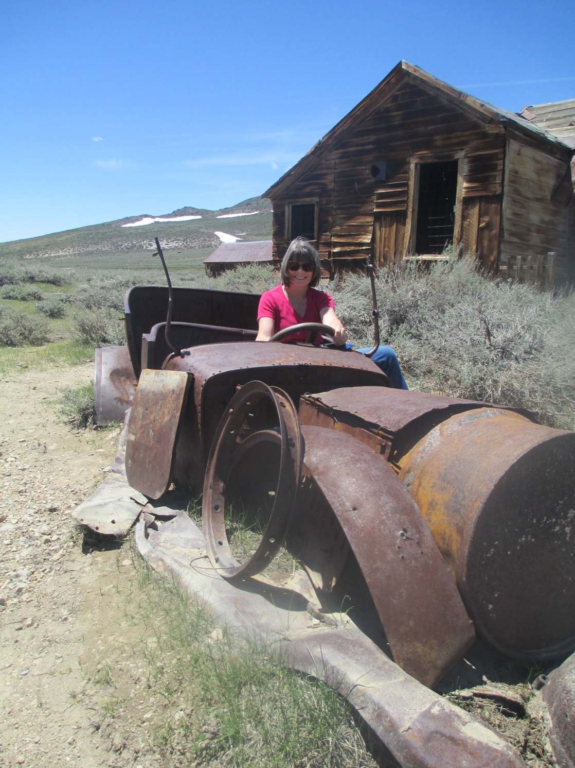
Bodie, CA
Michele test drives ‘new car’

Slide 3
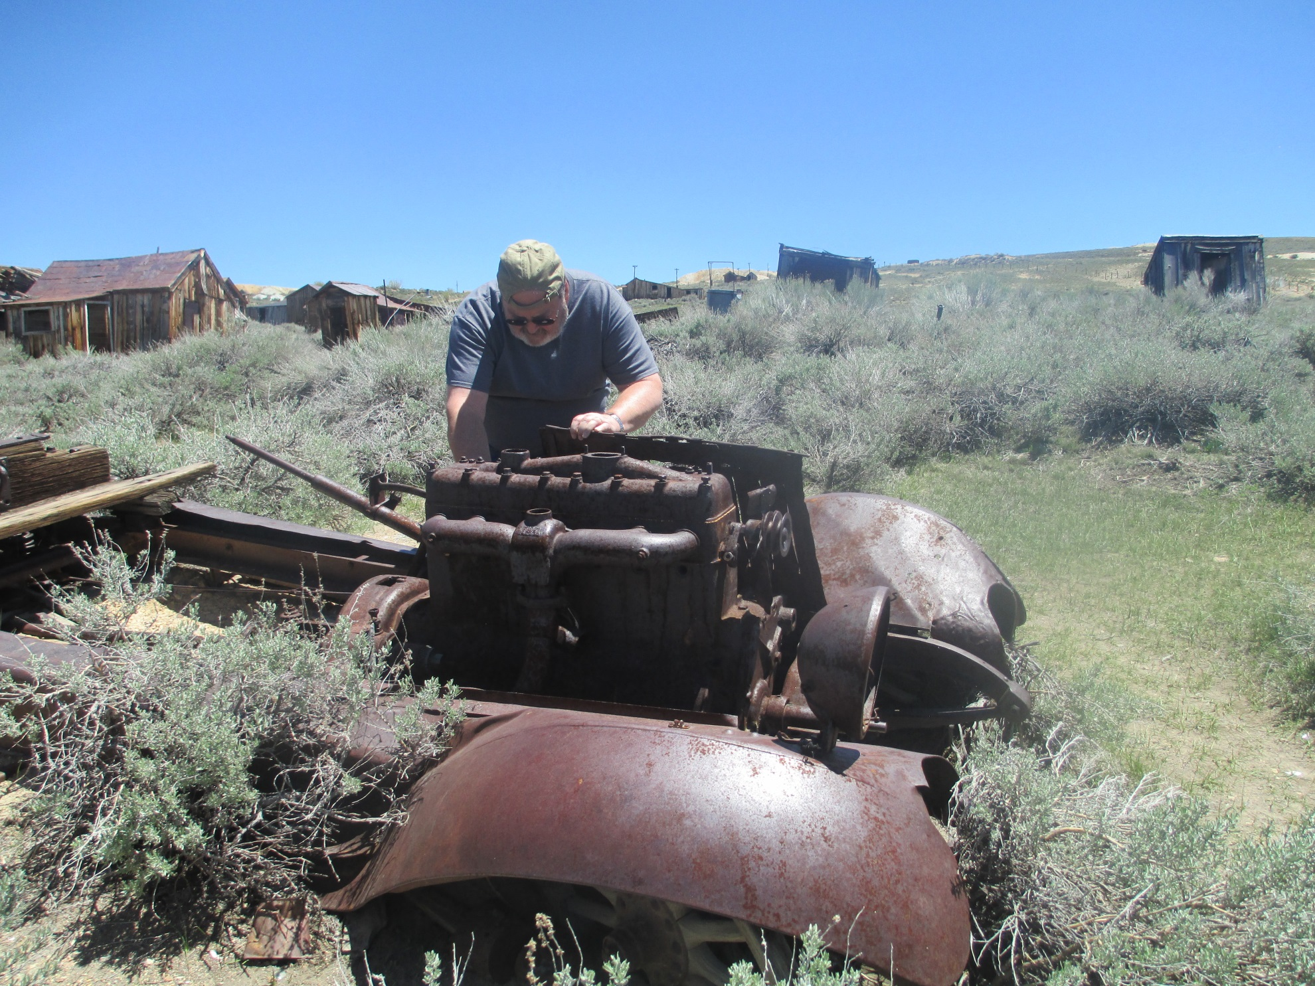
Bodie, CA
“Resurrection!”
C’mon - baby!!

Slide 4
Lake California
Community Church
Purpose/Vision/Value/Ministry
and
Property Update
Presented Nov. 12, 2017

Slide 5
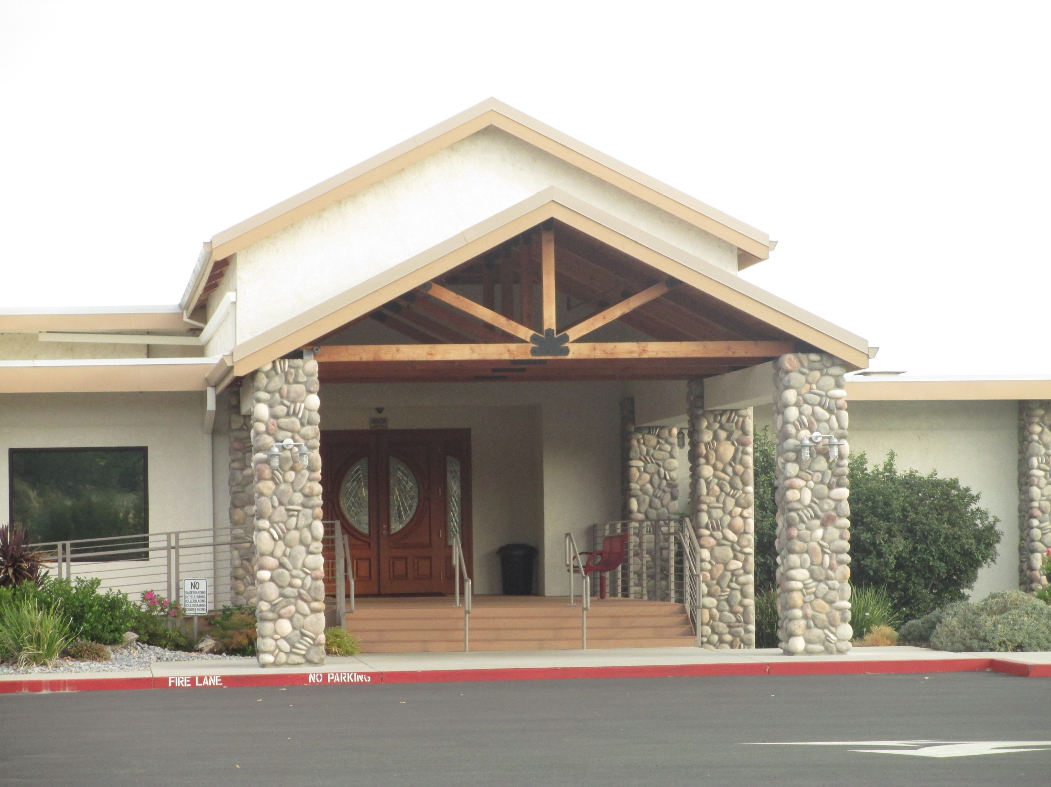

Slide 6
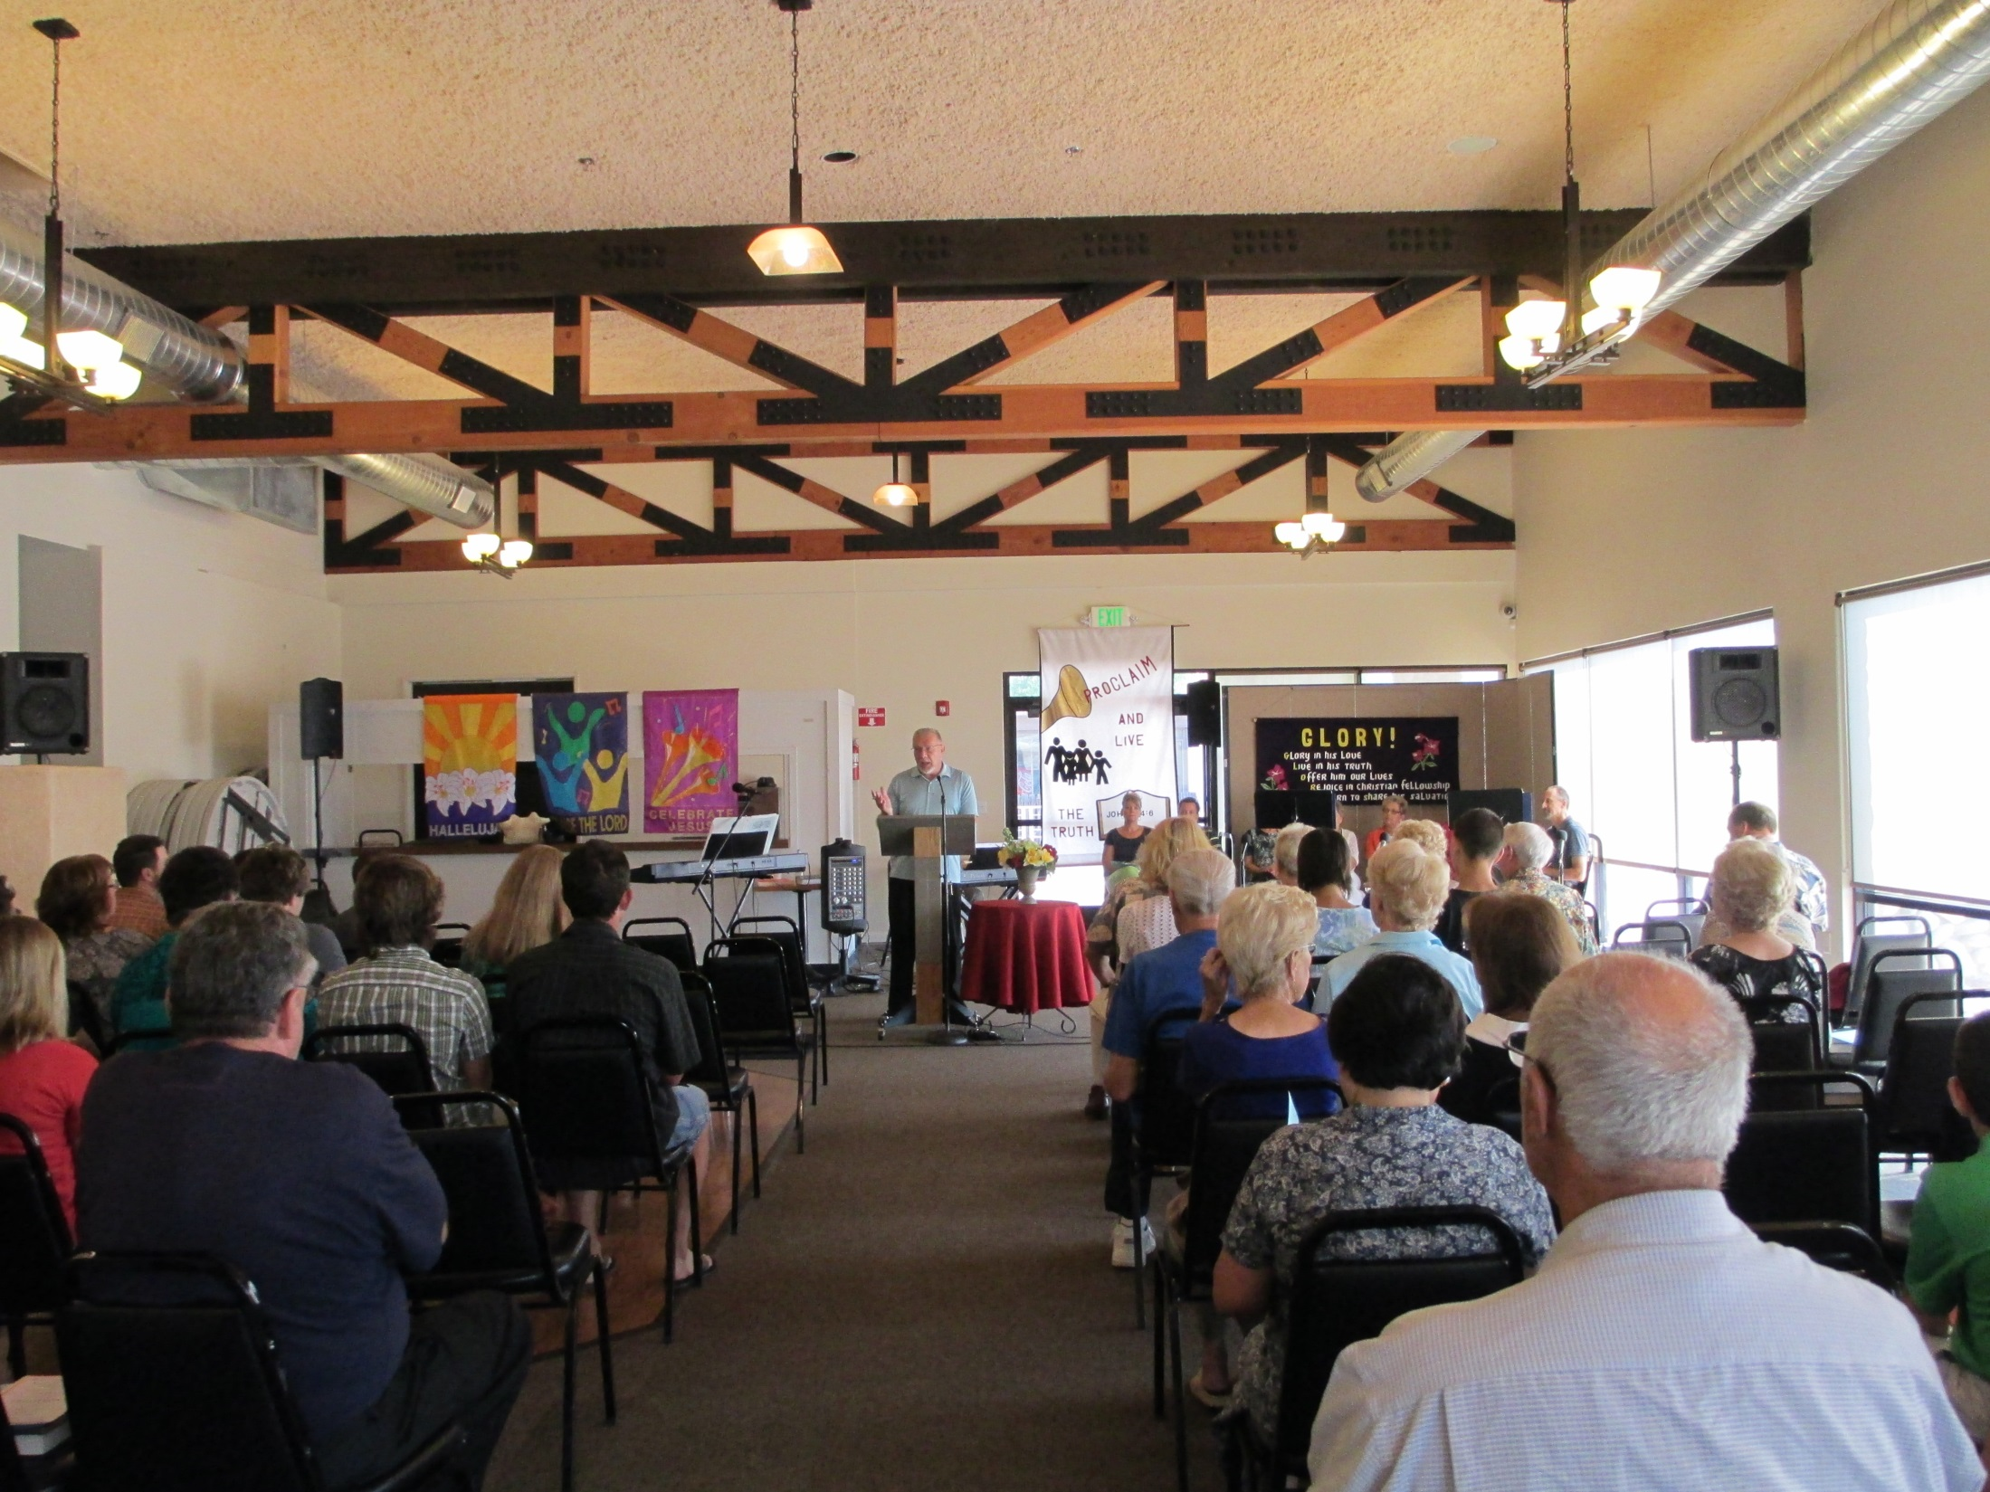

Slide 7
Question #1:
What has our Lord done
in/with/thru us
in the last 5 years?

Slide 8
Question #2:
Where are we going
in the future?

Slide 9
Question #2:
Where are we going
in the future?
“If you aim at nothing, you’ll hit it every time.”
Zig Ziglar/B.J. Marshall

Slide 10
Paul, the apostle, writes:
“Everyone who competes in the games goes into strict training. They do it to get a crown that will not last, but we do it to get a crown that will last forever. Therefore I do not run like someone running aimlessly; I do not fight like a boxer beating the air. No, I strike a blow to my body and make it my slave so that after I have preached to others, I myself will not be disqualified for the prize.”
1 Cor. 9:25-27

Slide 11
Intentional

Slide 12
Intentional
Strategic

Slide 13
Intentional
Strategic
Purposeful

Slide 14
Oct. 26th, a group of @ 14 people gathered with Brad Oaster of Harvestime, to prayerfully seek our Lord’s guidance in determining:

Slide 15
Oct. 26th, a group of @ 14 people gathered with Brad Oaster of Harvestime, to prayerfully seek our Lord’s guidance in determining:
Our Lord’s direction for LCCC

Slide 16
Oct. 26th, a group of @ 14 people gathered with Brad Oaster of Harvestime, to prayerfully seek our Lord’s guidance in determining:
Our Lord’s direction for LCCC
to express it in writing
– as a Road Map of –

Slide 17
Oct. 26th, a group of @ 14 people gathered with Brad Oaster of Harvestime, to prayerfully seek our Lord’s guidance in determining:
Our Lord’s direction for LCCC
to express it in writing
– as a Road Map of –
Our Purpose-Vision-Values

Slide 18
The Elders have prayerfully reviewed and edited it several times
(individually and as a group)
The Elders and Deacons have reviewed it and made minor changes
and accepted it.
We now present it to you.

Slide 19
Lake California Community Church
Cottonwood, California
Accepted by Elders: 10-26-2017 Rev. 3:11-06-17
Purpose Statement – why we exist

Slide 20
Lake California Community Church
Cottonwood, California
Accepted by Elders: 10-26-2017 Rev. 3:11-06-17
Purpose Statement – why we exist
Connect people to God and with others

Slide 21
Lake California Community Church
Cottonwood, California
Accepted by Elders: 10-26-2017 Rev. 3:11-06-17
Purpose Statement – why we exist
Connect people to God and with others
What does that mean?

Slide 22
Lake California Community Church
Cottonwood, California
Accepted by Elders: 10-26-2017 Rev. 3:11-06-17
Purpose Statement – why we exist
Connect people to God and with others
Connect people to God:
to build relationships with Gospel redemption as our specific purpose

Slide 23
Lake California Community Church
Cottonwood, California
Accepted by Elders: 10-26-2017 Rev. 3:11-06-17
Purpose Statement – why we exist
Connect people to God and with others
Connect people to God:
to build relationships with Gospel redemption as our specific purpose
with others:
in a loving and accepting family of Christ

Slide 24
Lake California Community Church
Vision Statement - A picture of our preferred future
By the year 2023, Lake California Community Church (LCCC) will be a vital, growing community of believers, meeting on our own campus, with a weekend attendance of 400, while annually connecting with 50% of our community.

Slide 25
Lake California Community Church
Vision Statement - A picture of our preferred future
By the year 2023, Lake California Community Church (LCCC) will be a vital, growing community of believers, meeting on our own campus, with a weekend attendance of 400, while annually connecting with 50% of our community.

Slide 26
Lake California Community Church
Vision Statement - A picture of our preferred future
By the year 2023, Lake California Community Church (LCCC) will be a vital, growing community of believers, meeting on our own campus, with a weekend attendance of 400, while annually connecting with 50% of our community.

Slide 27
Lake California Community Church
Vision Statement - A picture of our preferred future
By the year 2023, Lake California Community Church (LCCC) will be a vital, growing community of believers, meeting on our own campus, with a weekend attendance of 400, while annually connecting with 50% of our community.

Slide 28
Lake California Community Church
Vision Statement - A picture of our preferred future
By the year 2013, Lake California Community Church (LCCC) will be a vital, growing community of believers, meeting on our own campus, with a weekend attendance of 400, while annually connecting with 50% of our community.

Slide 29
Lake California Community Church
Vision Statement - A picture of our preferred future
By the year 2013, Lake California Community Church (LCCC) will be a vital, growing community of believers, meeting on our own campus, with a weekend attendance of 400, while annually connecting with 50% of our community.

Slide 30
Lake California Community Church
Vision Statement - A picture of our preferred future
By the year 2023, Lake California Community Church (LCCC) will be a vital, growing community of believers, meeting on our own campus, with a weekend attendance of 400, while annually connecting with 50% of our community.

Slide 31
Intentional
Strategic
Purposeful

Slide 32
Lake California Community Church
Our Value Proposition - what we offer our community

Slide 33
Lake California Community Church
Our Value Proposition - what we offer our community
Discover your purpose and live your dreams.

Slide 34
Lake California Community Church
Our Value Proposition - what we offer our community
Discover your purpose and live your dreams.
Purpose: true life in Christ

Slide 35
Lake California Community Church
Our Value Proposition - what we offer our community
Discover your purpose and live your dreams.
Purpose: true life in Christ
Live your dreams: abundant life
through Christ

Slide 36
Lake California Community Church
Our Target - our primary focus
As we serve our community(ies)both inside and outside “the gate”, our target is our neighbors, relatives and friends; the unchurched individual(s) who either was once a part of “the church” but has since left, or who has never engaged in church life.

Slide 37
Lake California Community Church
Our Target - our primary focus
As we serve our community(ies)both inside and outside “the gate”, our target is our neighbors, relatives and friends; the unchurched individual(s) who either was once a part of “the church” but has since left, or who has never engaged in church life.

Slide 38
Lake California Community Church
Our Target - our primary focus
As we serve our community(ies)both inside and outside “the gate”, our target is our neighbors, relatives and friends; the unchurched individual(s) who either was once a part of “the church” but has since left, or who has never engaged in church life.

Slide 39
Lake California Community Church
Our Target - our primary focus
As we serve our community(ies)both inside and outside “the gate”, our target is our neighbors, relatives and friends; the unchurched individual(s) who either was once a part of “the church” but has since left, or who has never engaged in church life.

Slide 40
Lake California Community Church
BUT, Wait!

Slide 41
Lake California Community Church
But, Wait!
What about people who are not neighbors, relatives or friends?

Slide 42
Lake California Community Church
But, Wait!
What about people who are not neighbors, relatives or friends?
As you are going – share Christ!
By actions & words where appropriate!
Make disciples of Christ!

Slide 43
Lake California Community Church
Our Target - our primary focus
As we serve our community(ies)both inside and outside “the gate”, our target is our neighbors, relatives and friends; the unchurched individual(s) who either was once a part of “the church” but has since left, or who has never engaged in church life.

Slide 44
Lake California Community Church
Our Mission Strategy – how we accomplish our purpose

Slide 45
Lake California Community Church
Our Mission Strategy – how we accomplish our purpose
What is our purpose?

Slide 46
Lake California Community Church
Our Mission Strategy – how we accomplish our purpose
What is our purpose?
Connect people to God and with others.

Slide 47
Lake California Community Church
Our Mission Strategy – how we accomplish our purpose
LCCC serves the communities of Lake California and Cottonwood by providing an “outreached focused” ministry in a loving and caring environment, where children, young adults, families, singles and seniors are encouraged, equipped and empowered to live the life that God intends.

Slide 48
Lake California Community Church
Our Mission Strategy – how we accomplish our purpose
LCCC serves the communities of Lake California and Cottonwood by providing an “outreached focused” ministry in a loving and caring environment, where children, young adults, families, singles and seniors are encouraged, equipped and empowered to live the life that God intends.

Slide 49
Lake California Community Church
Our Mission Strategy – how we accomplish our purpose
LCCC serves the communities of Lake California and Cottonwood by providing an “outreached focused” ministry in a loving and caring environment, where children, young adults, families, singles and seniors are encouraged, equipped and empowered to live the life that God intends.

Slide 50
Lake California Community Church
Our Mission Strategy – how we accomplish our purpose
LCCC serves the communities of Lake California and Cottonwood by providing an “outreached focused” ministry in a loving and caring environment, where children, young adults, families, singles and seniors are encouraged, equipped and empowered to live the life that God intends.

Slide 51
Lake California Community Church
Our Mission Strategy – how we accomplish our purpose
LCCC serves the communities of Lake California and Cottonwood by providing an “outreached focused” ministry in a loving and caring environment, where children, young adults, families, singles and seniors are encouraged, equipped and empowered to live the life that God intends.

Slide 52
Intentional
Strategic
Purposeful

Slide 53
Lake California Community Church
The 5-C’s Development Strategy
[Refer to your handout]

Slide 54
Lake California Community Church
The 5-C’s - our leadership development pipeline
Connect – with people in a relevant way

Slide 55
Lake California Community Church
The 5-C’s - our leadership development pipeline
Connect – with people in a relevant way
Celebrate – your new life in Christ

Slide 56
Lake California Community Church
The 5-C’s - our leadership development pipeline
Connect – with people in a relevant way
Celebrate – your new life in Christ
Cultivate – the life that God has for you

Slide 57
Lake California Community Church
The 5-C’s - our leadership development pipeline
Connect – with people in a relevant way
Celebrate – your new life in Christ
Cultivate – the life that God has for you
Contribute – to the body of Christ

Slide 58
Lake California Community Church
The 5-C’s - our leadership development pipeline
Connect – with people in a relevant way
Celebrate – your new life in Christ
Cultivate – the life that God has for you
Contribute – to the body of Christ
Care – for others living a life of service

Slide 59
Intentional
Strategic
Purposeful

Slide 60
Lake California Community Church
_________________________

Slide 61
Lake California Community Church
_________________________
Connect people to God and with others.

Slide 62
Lake California Community Church
Our Foundational Pillars - what our ministry is
built upon
The Bible – accurate teaching, understanding & application
Worship – involving our total lifestyle
Prayer – effectual & fervent
Evangelism – connection with the unchurched & “full-cycle”
Discipleship – teaching, equipping & empowering
Stewardship – of life and resources
Community – a loving, inclusive fellowship

Slide 63
Lake California Community Church
Essential Beliefs – How we relate to one another
In our essential beliefs, we desire unity;
Ephesians 4:4-6

Slide 64
Lake California Community Church
Essential Beliefs – How we relate to one another
In our essential beliefs, we desire unity;
Ephesians 4:4-6
In our non-essential beliefs, we have liberty;
Romans 14

Slide 65
Lake California Community Church
Essential Beliefs – How we relate to one another
In our essential beliefs, we desire unity;
Ephesians 4:4-6
In our non-essential beliefs, we have liberty;
Romans 14
In all beliefs, we show charity.
1 Corinthians 13:2

Slide 66
Lake California Community Church
Cove Values – What is important to us
Family – We value a family environment where all people are welcome;

Slide 67
Lake California Community Church
Cove Values – What is important to us
Family – We value a family environment where all people are welcome;
Community – We value community where people love and care for
one another

Slide 68
Lake California Community Church
Cove Values – What is important to us
Family – We value a family environment where all people are welcome;
Community – We value community where people love and care for
one another
Biblical Teaching – We value biblical teaching as it is relevant
to life

Slide 69
Lake California Community Church
Cove Values – What is important to us
Family – We value a family environment where all people are welcome;
Community – We value community where people love and care for
one another
Biblical Teaching – We value biblical teaching as it is relevant
to life
Integrity – We value integrity because we serve a Holy God

Slide 70
Lake California Community Church
Cove Values – What is important to us
Family – We value a family environment where all people are welcome;
Community – We value community where people love and care for
one another
Biblical Teaching – We value biblical teaching as it is relevant
to life
Integrity – We value integrity because we serve a Holy God
Fun – We value fun because God has a sense of humor

Slide 71
Lake California Community Church
Cove Values – What is important to us
Family – We value a family environment where all people are welcome;
Community – We value community where people love and care for
one another
Biblical Teaching – We value biblical teaching as it is relevant
to life
Integrity – We value integrity because we serve a Holy God
Fun – We value fun because God has a sense of humor
Life Change – We value life change because we are all on a journey
towards Christlikeness

Slide 72
Lake California Community Church
Cove Values – What is important to us
Family – We value a family environment where all people are welcome;
Community – We value community where people love and care for
one another
Biblical Teaching – We value biblical teaching as it is relevant
to life
Integrity – We value integrity because we serve a Holy God
Fun – We value fun because God has a sense of humor
Life Change – We value life change because we are all on a journey
towards Christlikeness
Children – We value children and invest in them that they will become
lovers of God

Slide 73
Lake California Community Church
Cove Values – What is important to us
Family – We value a family environment where all people are welcome;
Community – We value community where people love and care for
one another
Biblical Teaching – We value biblical teaching as it is relevant
to life
Integrity – We value integrity because we serve a Holy God
Fun – We value fun because God has a sense of humor
Life Change – We value life change because we are all on a journey
towards Christlikeness
Children – We value children and invest in them that they will become
lovers of God

Slide 74
Intentional
Strategic
Purposeful

Slide 75
Lake California Community Church
Key Performance Indicators (KPI’s) –
What we measure

Slide 76
Lake California Community Church
Key Performance Indicators (KPI’s) –
What we measure
Attendance on weekends

Slide 77
Lake California Community Church
Key Performance Indicators (KPI’s) –
What we measure
Attendance on weekends
Annual number of new converts

Slide 78
Lake California Community Church
Key Performance Indicators (KPI’s) –
What we measure
Attendance on weekends
Annual number of new converts
People having been baptized

Slide 79
Lake California Community Church
Key Performance Indicators (KPI’s) –
What we measure
Attendance on weekends
Annual number of new converts
People having been baptized
Percentage of members/attenders tithing

Slide 80
Lake California Community Church
Key Performance Indicators (KPI’s) –
What we measure
Attendance on weekends
Annual number of new converts
People having been baptized
Percentage of members/attenders tithing
Percentage of people involved in the Spiritual Development Pipeline

Slide 81
Lake California Community Church
Key Performance Indicators (KPI’s) –
What we measure
Attendance on weekends
Annual number of new converts
People having been baptized
Percentage of members/attenders tithing
Percentage of people involved in the Spiritual Development Pipeline
Number of people involved in “Connecting Point” ministries

Slide 82
Lake California Community Church
Key Performance Indicators (KPI’s) –
What we measure
Attendance on weekends
Annual number of new converts
People having been baptized
Percentage of members/attenders tithing
Percentage of people involved in the Spiritual Development Pipeline
Number of people involved in “Connecting Point” ministries
Number of volunteers/people ministering

Slide 83
Lake California Community Church
Key Performance Indicators (KPI’s) –
What we measure
Attendance on weekends
Annual number of new converts
People having been baptized
Percentage of members/attenders tithing
Percentage of people involved in the Spiritual Development Pipeline
Number of people involved in “Connecting Point” ministries
Number of volunteers/people ministering

Slide 84
Lake California Community Church
FINALLY!
What does success look like?

Slide 85
Lake California Community Church
What does success look like?
People connected to God who:
Demonstrate the fruits of the Spirit

Slide 86
Lake California Community Church
What does success look like?
People connected to God who:
Demonstrate the fruits of the Spirit
Have an effective prayer life

Slide 87
Lake California Community Church
What does success look like?
People connected to God who:
Demonstrate the fruits of the Spirit
Have an effective prayer life
Manage their households well (biblically)

Slide 88
Lake California Community Church
What does success look like?
People connected to God who:
Demonstrate the fruits of the Spirit
Have an effective prayer life
Manage their households well (biblically)
Give of their resources generously (hilariously)

Slide 89
Lake California Community Church
What does success look like?
People connected to God who:
Demonstrate the fruits of the Spirit
Have an effective prayer life
Manage their households well (biblically)
Give of their resources generously (hilariously)
Have a growing knowledge of the Word

Slide 90
Lake California Community Church
What does success look like?
People connected to God who:
Demonstrate the fruits of the Spirit
Have an effective prayer life
Manage their households well (biblically)
Give of their resources generously (hilariously)
Have a growing knowledge of the Word
Share their faith effectively (with confidence)

Slide 91
Lake California Community Church
What does success look like?
People connected to God who:
Demonstrate the fruits of the Spirit
Have an effective prayer life
Manage their households well (biblically)
Give of their resources generously (hilariously)
Have a growing knowledge of the Word
Share their faith effectively (with confidence)
Involvement in ministry (within their passion)

Slide 92
Lake California Community Church
What does success look like?
People connected to God who:
Demonstrate the fruits of the Spirit
Have an effective prayer life
Manage their households well (biblically)
Give of their resources generously (hilariously)
Have a growing knowledge of the Word
Share their faith effectively (with confidence)
Involvement in ministry (within their passion)

Slide 93
NOW,
What have you observed about all this information (other than it is a lot)?

Slide 94
NOW,
What have you observed about all this information (other than it is a lot)?
People focused Purposeful

Slide 95
NOW,
What have you observed about all this information (other than it is a lot)?
People focused Purposeful
Intentional Strategic Measurable

Slide 96
NOW,
What have you observed about all this information (other than it is a lot)?
People focused Purposeful
Intentional Strategic Measurable
Obtainable
in God’s strength & provision through us!

Slide 97
NOW,
What have you observed about all this information (other than it is a lot)?
People focused Purposeful
Intentional Strategic Measurable
Obtainable
in God’s strength & provision through us!
For His Glory!

Slide 98
5-Year Strategic Ministry Plan
(SMP)
Relax – just an overview!

Slide 99
5-Year Strategic Ministry Plan
Year 1 Year 2 Year 3 Year 4 Year 5
Vital & Growing
New believers
400 attenders
Own facility/campus
Discipling ministries
Effective Outreach
Growing Leadership

Slide 100
5-Year Strategic Ministry Plan
Year 1 Year 2 Year 3 Year 4 Year 5
Each member/attender
Committed to spiritual growth
Committed to reaching people for Christ
Committed to the Purpose, Vision, Mission & Values
Committed to personal involvement/ministry
Vital & Growing
New believers
400 attenders
Own facility/campus
Discipling ministries
Effective Outreach
Growing Leadership

Slide 101
5-Year Strategic Ministry Plan
Year 1 Year 2 Year 3 Year 4 Year 5
Each member/attender
Committed to spiritual growth
Committed to reaching people for Christ
Committed to the Purpose, Vision, Mission & Values
Committed to personal involvement/ministry
Vital & Growing
New believers
400 attenders
Own facility/campus
Discipling ministries
Effective Outreach
Growing Leadership
Each ministry committed to excellence and effectiveness
developing a Ministry 5-Yr Plan w/5-Yr SMP as guide

Slide 102
5-Year Strategic Ministry Plan
Year 1 Year 2 Year 3 Year 4 Year 5
Each member/attender
Committed to spiritual growth
Committed to reaching people for Christ
Committed to the Purpose, Vision, Mission & Values
Committed to personal involvement/ministry
Vital & Growing
New believers
400 attenders
Own facility/campus
Discipling ministries
Effective Outreach
Growing Leadership
Each ministry committed to excellence and effectiveness
developing a Ministry 5-Yr Plan w/5-Yr SMP as guide
Campus Development

Slide 103
5-Year Strategic Ministry Plan
Year 1 Year 2 Year 3 Year 4 Year 5
Each member/attender
Committed to spiritual growth
Committed to reaching people for Christ
Committed to the Purpose, Vision, Mission & Values
Committed to personal involvement/ministry
Vital & Growing
New believers
400 attenders
Own facility/campus
Discipling ministries
Effective Outreach
Growing Leadership
Each ministry committed to excellence and effectiveness
developing a Ministry 5-Yr Plan w/5-Yr SMP as guide
Campus Development
Body-wide commitment to provide the tools to
effectively minister to the community

Slide 104
5-Year Strategic Ministry Plan
Year 1 Year 2 Year 3 Year 4 Year 5
Each member/attender
Committed to spiritual growth
Committed to reaching people for Christ
Committed to the Purpose, Vision, Mission & Values
Committed to personal involvement/ministry
Vital & Growing
New believers
400 attenders
Own facility/campus
Discipling ministries
Effective Outreach
Growing Leadership
Each ministry committed to excellence and effectiveness
developing a Ministry 5-Yr Plan w/5-Yr SMP as guide
Campus Development
Body-wide commitment to provide the tools to
effectively minister to the community
Commitment before the Lord of Time, Talent & Resources

Slide 105
5-Year Strategic Ministry Plan
Year 1 Year 2 Year 3 Year 4 Year 5
Each member/attender
Committed to spiritual growth
Committed to reaching people for Christ
Committed to the Purpose, Vision, Mission & Values
Committed to personal involvement/ministry
Vital & Growing
New believers
400 attenders
Own facility/campus
Discipling ministries
Effective Outreach
Growing Leadership
Each ministry committed to excellence and effectiveness
developing a Ministry 5-Yr Plan w/5-Yr SMP as guide
Campus Development
Body-wide commitment to provide the tools to
effectively minister to the community
Commitment before the Lord of Time, Talent & Resources

Slide 106
So . . .
what about
the ‘campus’,
the new church facility?

Slide 107
As the Elders have wrestled with this, we felt that the total project – civil engineering (parking, lights , landscape, etc.), the building (permits, construction, etc.) and contents (FF&E) needed to be in the neighborhood of
$_____________________.

Slide 108
As the Elders have wrestled with this, we felt that the total project – civil engineering (parking, lights , landscape, etc.), the building (permits, construction, etc.) and contents (FF&E) needed to be in the neighborhood of
$1 million dollars.
[That’s a lot! But listen . . .]

Slide 109
Initially, the plan was:
Seating 250 in worship service
A Worship Center – multipurpose for outreach
Adequate CE space & offices
And a bit more
The cost was @ $1.8 million

Slide 110
So, in late September, the Elders prayerfully determined the $-amt was to be in the $1 million range ~ the question was:

Slide 111
So, in late September, the Elders prayerfully determined the $-amt was to be in the $1 million range ~ the question was:
What do we need
to facilitate what we have plus
a little more for growth?
[This is a planned squeeze but
we believe the bare essential for moving forward!]

Slide 112
We decided on:
Phase 1 ~ Worship Center (multipurpose) seating 125-ish with CE space; and,
Phase 2 ~ a larger WC w/greater outreach capacity, more CE space and offices

Slide 113
With the help of Brad Oaster of Harvestime, we are anticipating:
@ 5700 sq. ft. (internal)
Multipurpose Worship Center (125 seat)
Children’s Ministry area (with security)
A kitchen/food warming space
Foyer large enough for traffic movement and chatting

Slide 114
With the help of Brad Oaster of Harvestime, we are anticipating:
@ 5700 sq. ft. (internal)
Multipurpose Worship Center (125 seat)
Children’s Ministry area (with security)
A kitchen/food warming space
Foyer large enough for traffic movement and chatting
Anticipate cost is $1 to $1.1 Million

Slide 115
So, let’s look at the numbers first:
Cost: $1,100,000
Cash O/H $ 350,000
Needed $ 750, 000

Slide 116
So, let’s look at the numbers first:
Cost: $1,100,000
Cash O/H $ 350,000
Needed $ 750, 000
So, how do we raise it?

Slide 117
We believe that God will provide for this project through His people!
IFF we believe/convinced that:
God wants us to reach our communities
a strategic part of that is our own facility
=> Are God’s arms too short? (What has He done???)

Slide 118
We believe God has wowed us and . . .
HE will WOW us even more!

Slide 119
We believe that God desires us to take ownership and join Him in where He is at work.
It’s a step of faith . . .
It’s a sacrificial heart that realizes that it’s not just $$ - BUT it is investment in lives and eternity.

Slide 120
We believe that, as we follow our Lord, in HIS work of reaching our community(ies), part of that “ownership” includes the freedom which our own facility will provide.
Freedom to minister 24/7 as the Spirit leads us!

Slide 121
So, let’s do some math:
In 2016, LCCC had 74+ giving units.
If each giving unit sacrificially gave an average of
$ 212 per month = $15,688 per month
OR
$188,256 per year
OR
4 years to be in debt free

Slide 122
Rather than doing a 3-4 year
Fundraising Campaign
We are dividing the amount needed into 4 equal “$$-amounts”

Slide 123
Rather than doing a 3-4 year
Fundraising Campaign
We are dividing the amount needed into 4 equal “$$-amounts”
$187,000
$187,000
$187,000
$187,000

Slide 124
Rather than doing a 3-4 year
Fundraising Campaign
We are dividing the mount needed into 4 equal “$$-amounts”
$187,000
$187,000
$187,000
$187,000
MOMENTUM INCREASES OVER PROJECT

Slide 126
Cash On Hand
$350K
Phase 1

Slide 127
Cash On Hand
$350K
Phase 1
1st
$187,000
($537K)
_______
Civil Work:
Parking
Landscape
Surface H20
Play Area
Etc.
Cost @ $290-315K
Balance
$222K

Slide 128
Cash On Hand
$350K
Phase 1
2nd
$187,000
(@$409K)
_______
Prepare to Break Ground
on building w/in this
$-bracket
___
Permits
Construction
Etc.
1st
$187,000
($537K)
_______
Civil Work:
Parking
Landscape
Surface H20
Play Area
Etc.
Cost @ $290-315K
Balance
$222K

Slide 129
Cash On Hand
$350K
Phase 1
3rd
$187,000
(@$596K)
_______
Construction time @ 12 months
Cost @
$640k
2nd
$187,000
(@$409K)
_______
Prepare to Break Ground
on building w/in this
$-bracket
___
Permits
Construction
Etc.
1st
$187,000
($537K)
_______
Civil Work:
Parking
Landscape
Surface H20
Play Area
Etc.
Cost @ $290-315K
Balance
$222K

Slide 130
Cash On Hand
$350K
4th
$187,000
(@$783K)
_______
Final of construction and pay for FF&E
[Finance unavailable portion]
Cost @
$143K
Phase 1
3rd
$187,000
(@$596K)
_______
Construction time @ 12 months
Cost @
$640k
2nd
$187,000
(@$409K)
_______
Prepare to Break Ground
on building w/in this
$-bracket
___
Permits
Construction
Etc.
1st
$187,000
($537K)
_______
Civil Work:
Parking
Landscape
Surface H20
Play Area
Etc.
Cost @ $290-315K
Balance
$222K

Slide 131
Cash On Hand
$350K
4th
$187,000
(@$783K)
_______
Final of construction and pay for FF&E
[Finance unavailable portion]
Cost @
$143K
Phase 1
3rd
$187,000
(@$596K)
_______
Construction time @ 12 months
Cost @
$640k
2nd
$187,000
(@$409K)
_______
Prepare to Break Ground
on building w/in this
$-bracket
___
Permits
Construction
Etc.
1st
$187,000
($537K)
_______
Civil Work:
Parking
Landscape
Surface H20
Play Area
Etc.
Cost @ $290-315K
Balance
$222K
MOMENTUM INCREASES OVER PROJECT

Slide 132
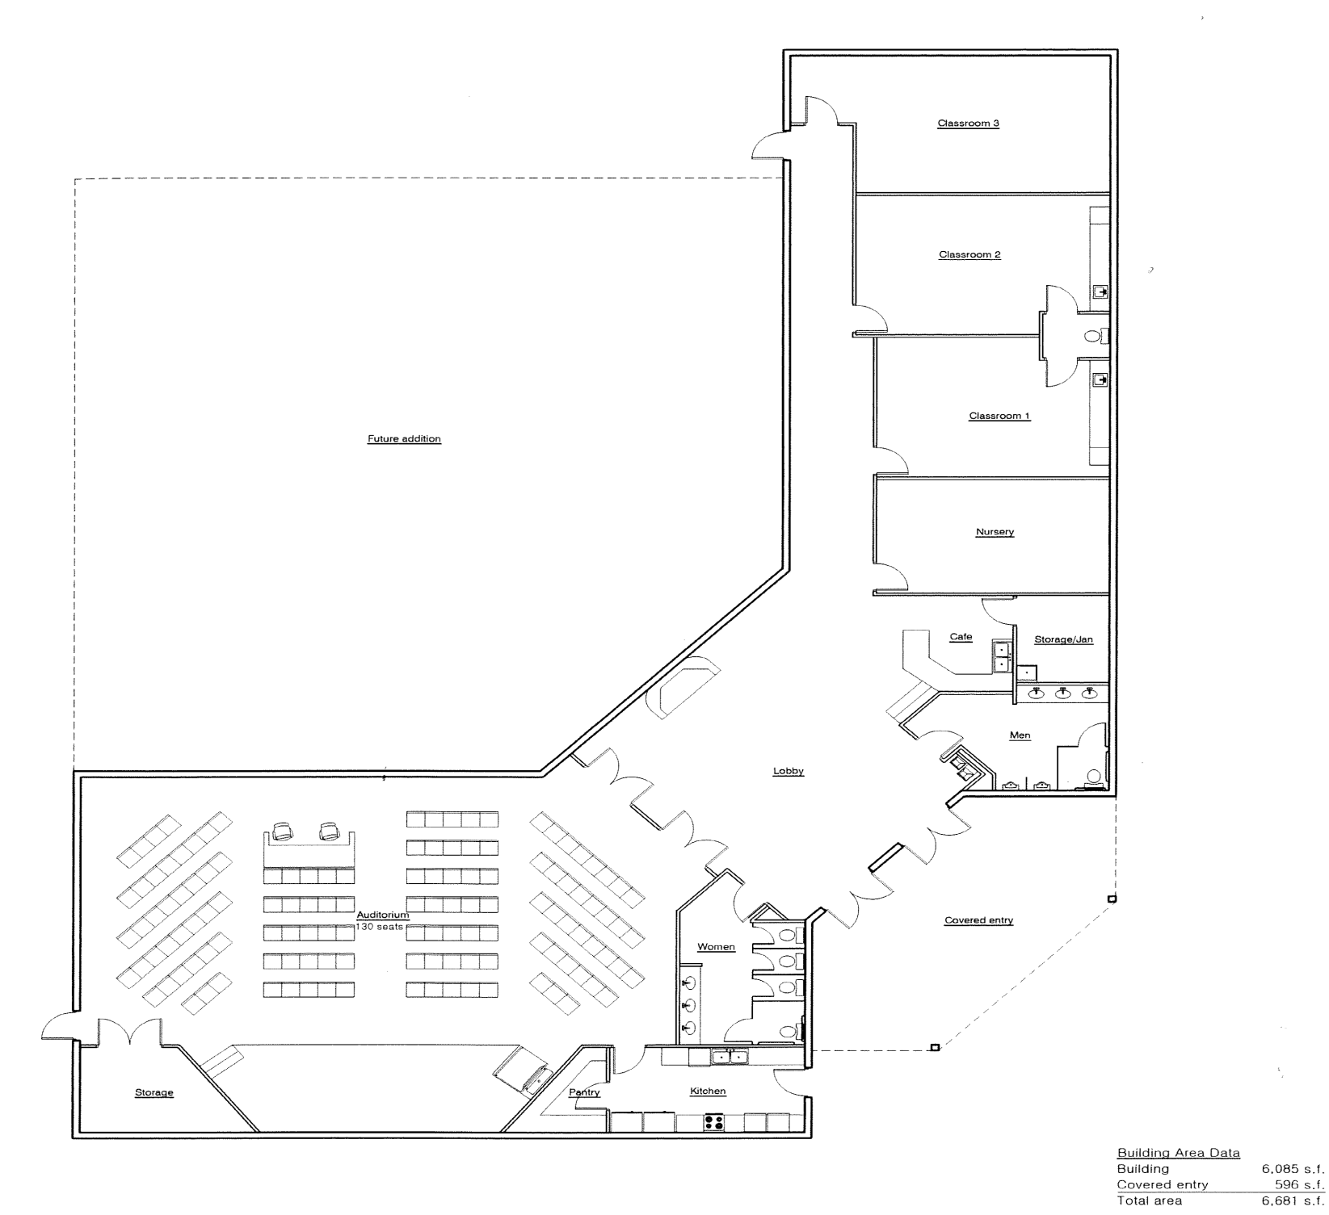
Preliminary Design
Yet to be designed

Slide 133
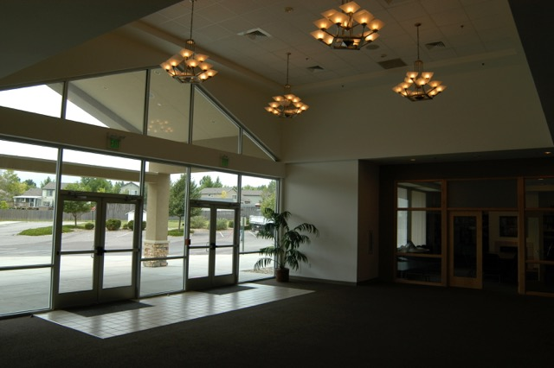

Slide 134
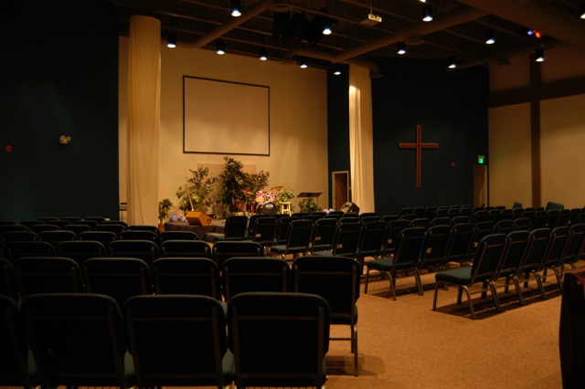

Slide 135
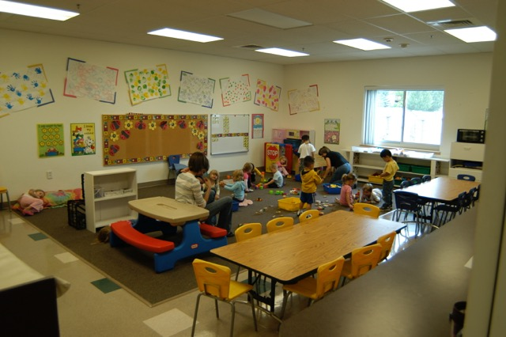

Slide 136
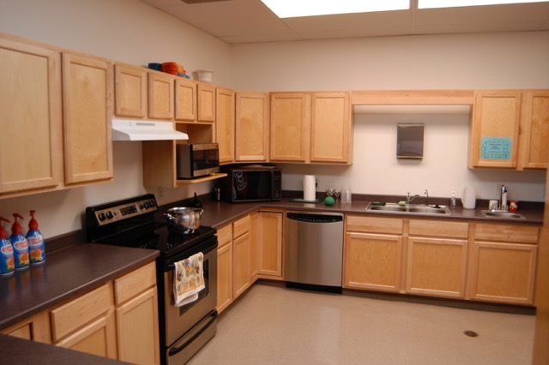

Slide 137
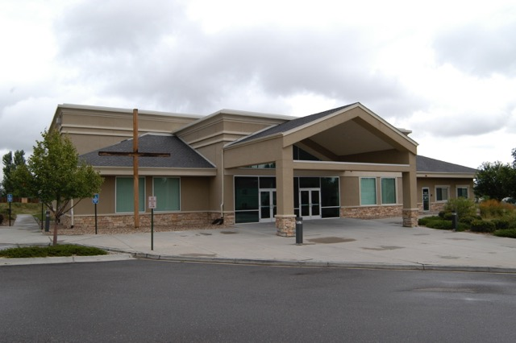

Slide 138
WOW! That’s sounds really great but $212 is a lot of money on a regular basis . . .
YES, it is! Some can give more, others must give less ~ but here’s the real encouragement to you . . .

Slide 139
GOD
“Let each of us consider in our
heart what our Lord would
have us to do, what He would
ask us to sacrifice for a period of
time, and to lay it aside as a
love offering to Him!” Whether we have much or little, we are to be faithful stewards.

Slide 140
If you drink a gourmet coffee
every day:
5 X $4.00 = $20/wk

Slide 141
If you drink a gourmet coffee
every day:
5 X $4.00 = $20/wk
Jim – you might be meddling!!!

Slide 142
If you drink a gourmet coffee
every day:
5 X $4.00 = $20/wk
2 X $4.00 = $ 8/wk
OR $32/mo.

Slide 143
If you drink a gourmet coffee
every day:
5 X $4.00 = $20/wk
2 X $4.00 = $ 8/wk
OR $32/mo.
If you go out to dinner 3 X ea month:
3 X $40 = $120/mo.

Slide 144
If you drink a gourmet coffee
every day:
5 X $4.00 = $20/wk
2 X $4.00 = $ 8/wk
OR $32/mo.
If you go out to dinner 3 X ea month:
3 X $40 = $120/mo.
1 X $40 = $ 40/mo.

Slide 145
If you drink a gourmet coffee
every day:
5 X $4.00 = $20/wk
2 X $4.00 = $ 8/wk
OR $32/mo.
If you go out to dinner 3 X ea month:
3 X $40 = $120/mo.
1 X $40 = $ 40/mo.
Let’s see: $32 + $40 = $72 !!!

Slide 146
If you drink a gourmet coffee
every day:
5 X $4.00 = $20/wk
2 X $4.00 = $ 8/wk
OR $32/mo.
If you go out to dinner 3 X ea month:
3 X $40 = $120/mo.
1 X $40 = $ 40/mo.
Let’s see: $32 + $40 = $72 !!!
[What about lunches, extra trips, etc?]

Slide 147
The “real question” for each one of us is:

Slide 148
The “real question” is:
“Lord, help us to see where we can cut back so we can invest more in Your work.”

Slide 149
And, BTW ~

Slide 150
And, BTW ~
This needs to be over and above your regular giving – the ministry must go on!

Slide 151
And, BTW ~
This needs to be over and above your regular giving – the ministry must go on!
But it is only for a season!

Slide 152
My/Our Commitment:
After seeking the Lord through prayer, my/our
commitment to the Lord, the LCCC Body & Elders as we prepare to move forward in His leading is to invest $_______ each month in the new building, and should He prosper me/us, I/we will invest more. For His Glory
Please return within 2 weeks

Slide 153
My/Our Commitment:
After seeking the Lord through prayer, my/our
commitment to the Lord, the LCCC Body & Elders as we prepare to move forward in His leading is to invest $_______ each month in the new building, and should He prosper me/us, I/we will invest more. For His Glory
Please return within 2 weeks
No names, just your investment.

Slide 154
The Lord, our Lord, has brought us to this place, this time . . .

Slide 155
The Lord, our Lord, has brought us to this place, this time . . .
for His purpose, to join with Him
and be His channel to reach . . .

Slide 156
The Lord, our Lord, has brought us to this place, this time . . .
for His purpose, to join with Him
and be His channel to reach . . .
to disciple, to grow, to be a part of His harvest . . .

Slide 157
The Lord, our Lord, has brought us to this place, this time . . .
for His purpose, to join with Him
and be His channel to reach . . .
to disciple, to grow, to be a part of His harvest . . .
the harvest is ready, the workers are few, pray the Lord of the harvest!

Slide 158
Let’s join Him!

